Slide 1
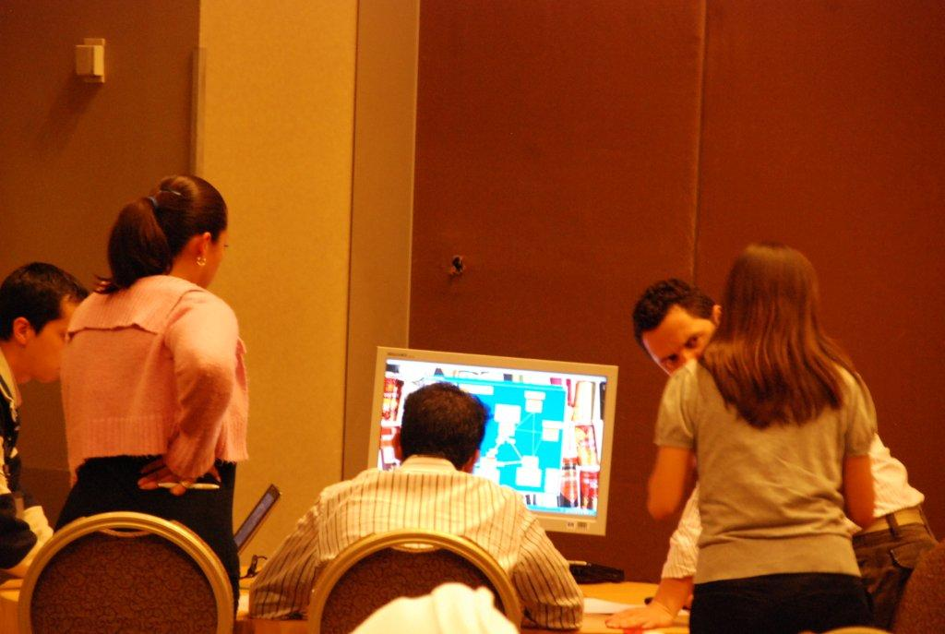
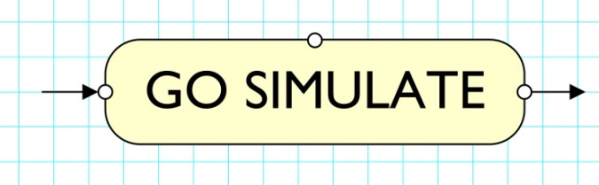

Live-Action Learning
Business Simulation Games
Overview
Contacts:
Rob Lees +44-(0)-7785-111999
rob.lees@go-simulate.com
Leeds Reyner +44-(0)-7770-440991
leeds.reyner@go-simulate.com
www.go-simulate.com
Spiros Kourkoulos +44 1227 860375
kourkoulos@apricot-consulting.com
www.apricot-consulting.com
Go Simulate was previously named Do>Learn>Do

Slide 2
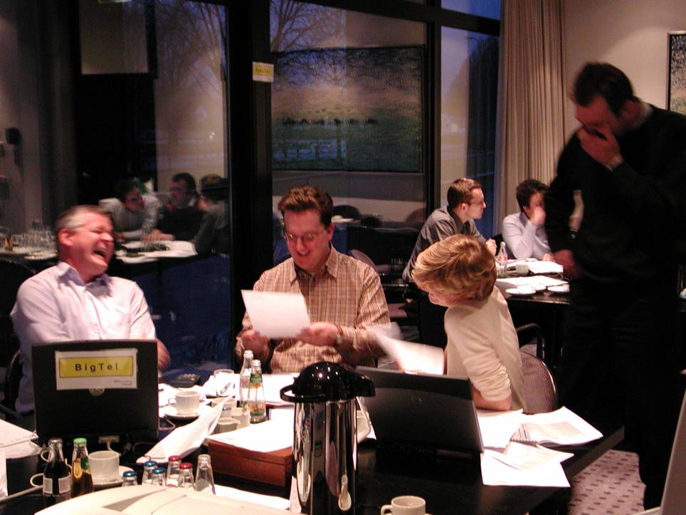
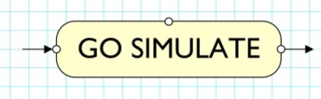
Creating almost real-life commercial environments combining data, expertise and technology to give participants practical, long-lasting and enjoyable learning that is applied in the day-to-day job.
Knowledge into
Action
Off-the-shelf Simulations
Customized Versions
Bespoke Simulations

Slide 3









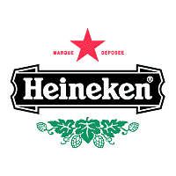












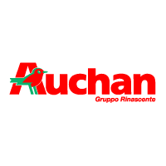




56 client users
660 courses
10,900 participants
5 languages
34 countries

Slide 4

4 teams each with laptop – live link to tutor laptop
Each team plays the part of one company function each round
Operations, Logistics, Purchasing & Commercial
Teams must work together to achieve value chain optimisation
Teams change functional role each round
Series of scenarios; customer-related factors & internal disruptions
Commercial team in customer-facing role-play that determines volume and pattern of demand – 4 products; 4 customers; 6 months, month-by-month
If chain not optimised – this will result in lost value
On-going coaching is given to teams during the live activity
The 4 individual plans at deadline are combined by the system to run reports – P & L, Cash Flow, Availability, Supply Chain Status
END>TO>END VALUE
Supply Chain Efficiency
& Availability
“Work together to give 100% customer service at lowest possible cost”
Full package available in German language
Benefits of this game
Helps to create an efficient, responsive and cost effective end-to-end value chain which is a must to satisfy customers
Enables functional teams to practice response to surges, sudden events, external dislocations that test the organisation’s service and value in the eyes of client’s customers
Helps individuals and teams to adopt better cross-functional communication & collaboration back in the workplace - overcoming the ‘silo’ mentality
Network landscape map that
gives live update of all functional
plans and how close the plans
integrate to an optimised situation
Shortages in red!
Contact: rob.lees@gmail.com 07785-111999

Slide 5
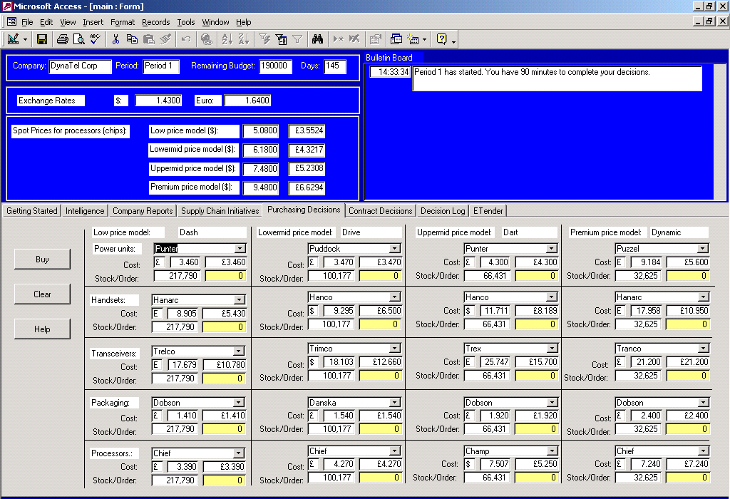
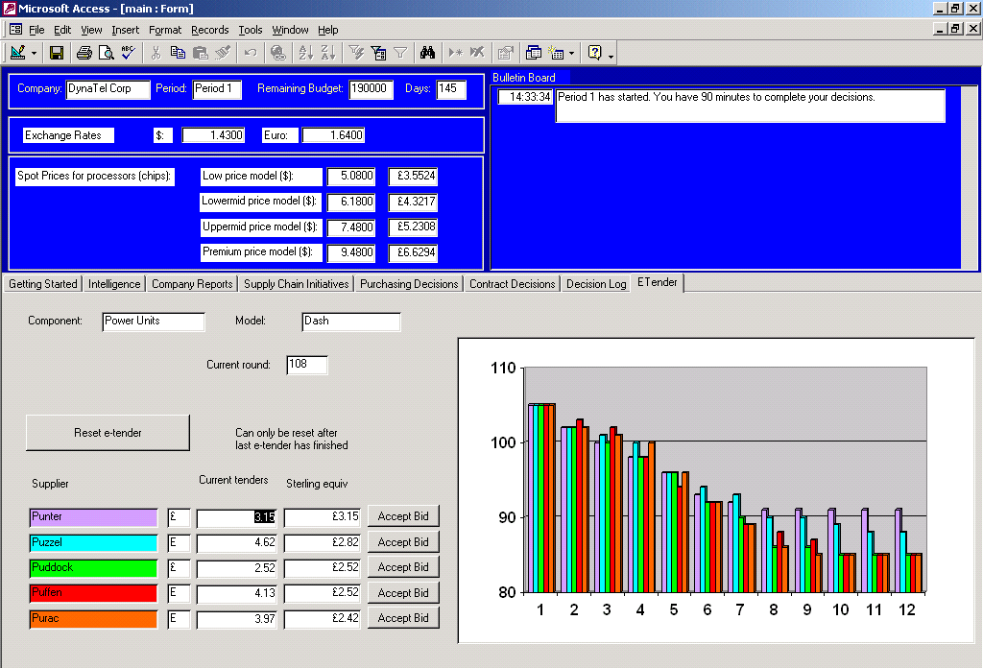
Learning to use strategy and apply consistent procurement tools
4 Teams - 4 competing companies – live network
Procurement departments of rival mobile phone manufacturers
Objective is to optimise sourcing of components & indirect services
Runs over 5 rounds – full set of reports after each round
Teams must use professional procurement strategy to inform thinking
Teams present privately after round 3 to “boss”
No marketing/sales decisions
20 intelligence-gathering options to assess supply markets/suppliers
Execute sourcing plans using 20 procurement tools e.g. hedging, E-auctions
Must prioritise, quantify best value, execute tools in line with strategy
Great buzz and high learning impact
STRATEGIC BUYER
Smart Procurement
Strategy & Tools
“Use procurement strategy technique to devise and implement optimum source plan for cost & value”
Full package available in German language
Supplier Assessment
Spend Analysis
Strategy Development
Contract Options
Supplier Rationalisation
Supplier Collaboration
Currency & Commodity Hedging
Supplier Costs
Supplier Quality & Service
Improvements
E-auction
Out-sourcing
Cost-benchmarking
Learning
List of tools

Slide 6
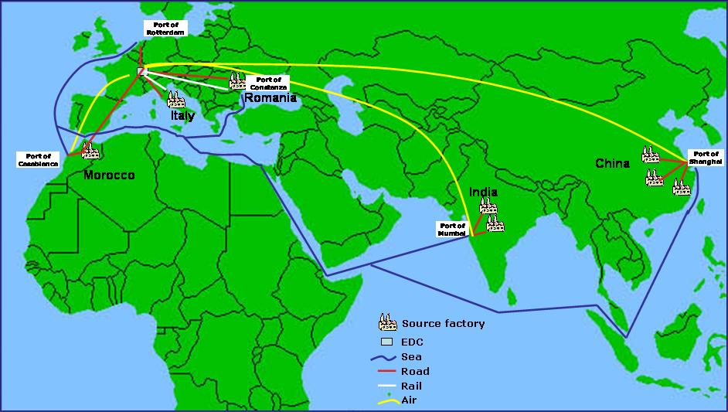
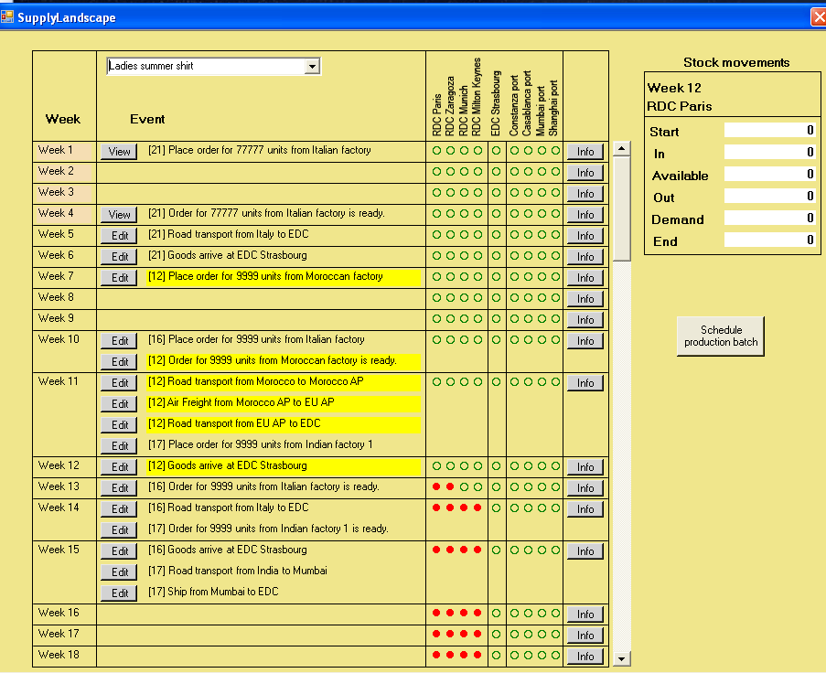
Provides participants with understanding of the risks - lead time flexibility - and costs of global sourcing and the importance of a total cost perspective.
Teams are companies sourcing 4 garments for the European market via an European DC and 4 Regional DCs
The garments have brand characteristics that require different sourcing and distribution network solutions & different seasonality
8 potential global sources with different profiles - costs, manufacturing lead times, production rates, quality, transport route options, demand patterns – different by garment
Runs over 64 ‘live’ weeks in 8-week buckets
Underlying volume demand forecast updated every week – plus affected by garment quality and availability
Improved sourcing and supply network plans lead to better profit performance
GLOBAL SOURCING
& SUPPLY
Lean & Agile Network
Decisions in geographic sourcing, supplier selection, order quantities, inventory holding points and transport modes in order to optimise cost, availability, responsiveness and ultimately profit
Cursor Activated to
track:
Order placed
Order ready
Order transported
Order delivered to
network locations
See latest forecast
product availability
at locations
4 garments
8 potential sources
Many supply network options
Built in conjunction with
Cranfield School of Management

Slide 7

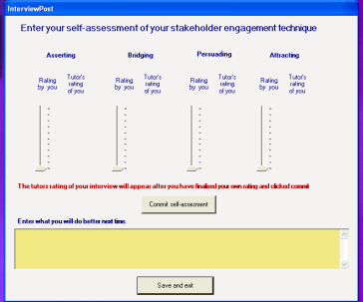
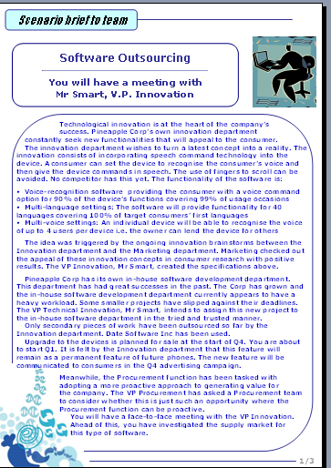
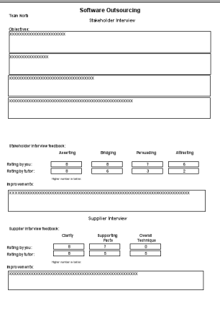

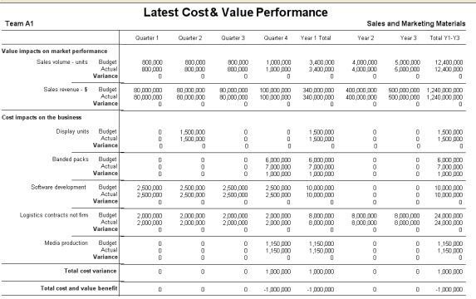
Participants rapidly improve their awareness of how to buy for better cost & value and to improve their interpersonal skill in persuading stakeholders to agree to optimised approach
Teams work in indirect procurement for mythical “Pineapple Corp””
Baseline procurement budget can be beaten by achieving cost reductions and by value added that improves company performance in non-cost ways
A series of services procurement scenarios in different categories
Teams hold role-plays with stakeholders – the success of how well they apply good technique in the meeting determines how good the sourcing scope and contract structure they can deploy
Teams may also role-play dealing with a strategic supplier in order to get a better final contract
The software is used to manage what’s going on with all the teams
The system generates the financial results, missed opportunities and interpersonal skill assessments for the scenario – teams compare how they did
INFLUENCING
STAKEHOLDERS
“Practicing stakeholder engagement skill to get better sourcing scope and hence get better cost & value”
Scenario briefing
Results of role-play into PC - PC specifies scope for team’s RFXs
Role-play with stakeholder
Technique: Self-assessments and tutor assessments are logged for ‘do better next time’ - also printed out
Better stakeholder engagement technique + commercial sharpness
= better COST & VALUE
Pineapple Corp

Slide 8
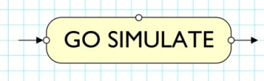
3 brand supplier teams trade with 3 retailer teams – fictional juice category
4 trading periods with real-life trading information
Each team gets 15 face-to-face meetings (negotiations)
(Initial round + 4 trading rounds – meet all 3 trade partners each time)
Decisions are captured on laptop and performance reports are generated each trading period – aim is to improve Win-Win combination
Coaching support given throughout the course by experienced commercial operators
Participants may use pre-defined sales & marketing techniques
‘Skill-shot’ sessions are delivered between rounds
WIN-WIN
Practice Buyer-Seller
Interaction
“Sharpen commercial & negotiation skills, experience the grocery buyer mind-set”
BOTH TRADE PARTNERS
Profit
Sales revenue
Consumer-shopper satisfaction
SUPPLIER SIDE
Listings
Fixture Location Fixture Quality Fixture Space
Trade Terms
Investment
Promotion Advertising
THE SALES DRIVERS
RETAILER SIDE
Assortment Fixture Location Fixture Quality Fixture Space Retail Pricing Promotion Type Promotion Weight
THE CATEGORY DRIVERS
RANGE
Standard juice drink
Low calorie juice drink
Children's drink
Sport drink
Own label

Slide 9
Bespoke Games - Examples
D>L>D develops bespoke games to the specific requirements of clients
Game | Client
Grocery Category Management | Institute of Grocery Distribution UK (IGD)
Efficient Intraday Liquidity Management | SEPA Consulting, City of London - Banking Sector
Cost-price Reduction & Best Value GNFR (Goods not for resale) | B&Q (DIY Retailer)
Fuels Value Chain | BP International
Retail Customer Profitability | Coca-Cola
Sales Force Effectiveness | Nestlé
Pub Segmentation & Demographics | Diageo
Languages
German Portuguese Italian Russian Chinese Spanish
Client Customising
Objectives Scenario Category Data values Process Terminology

